Slide 1
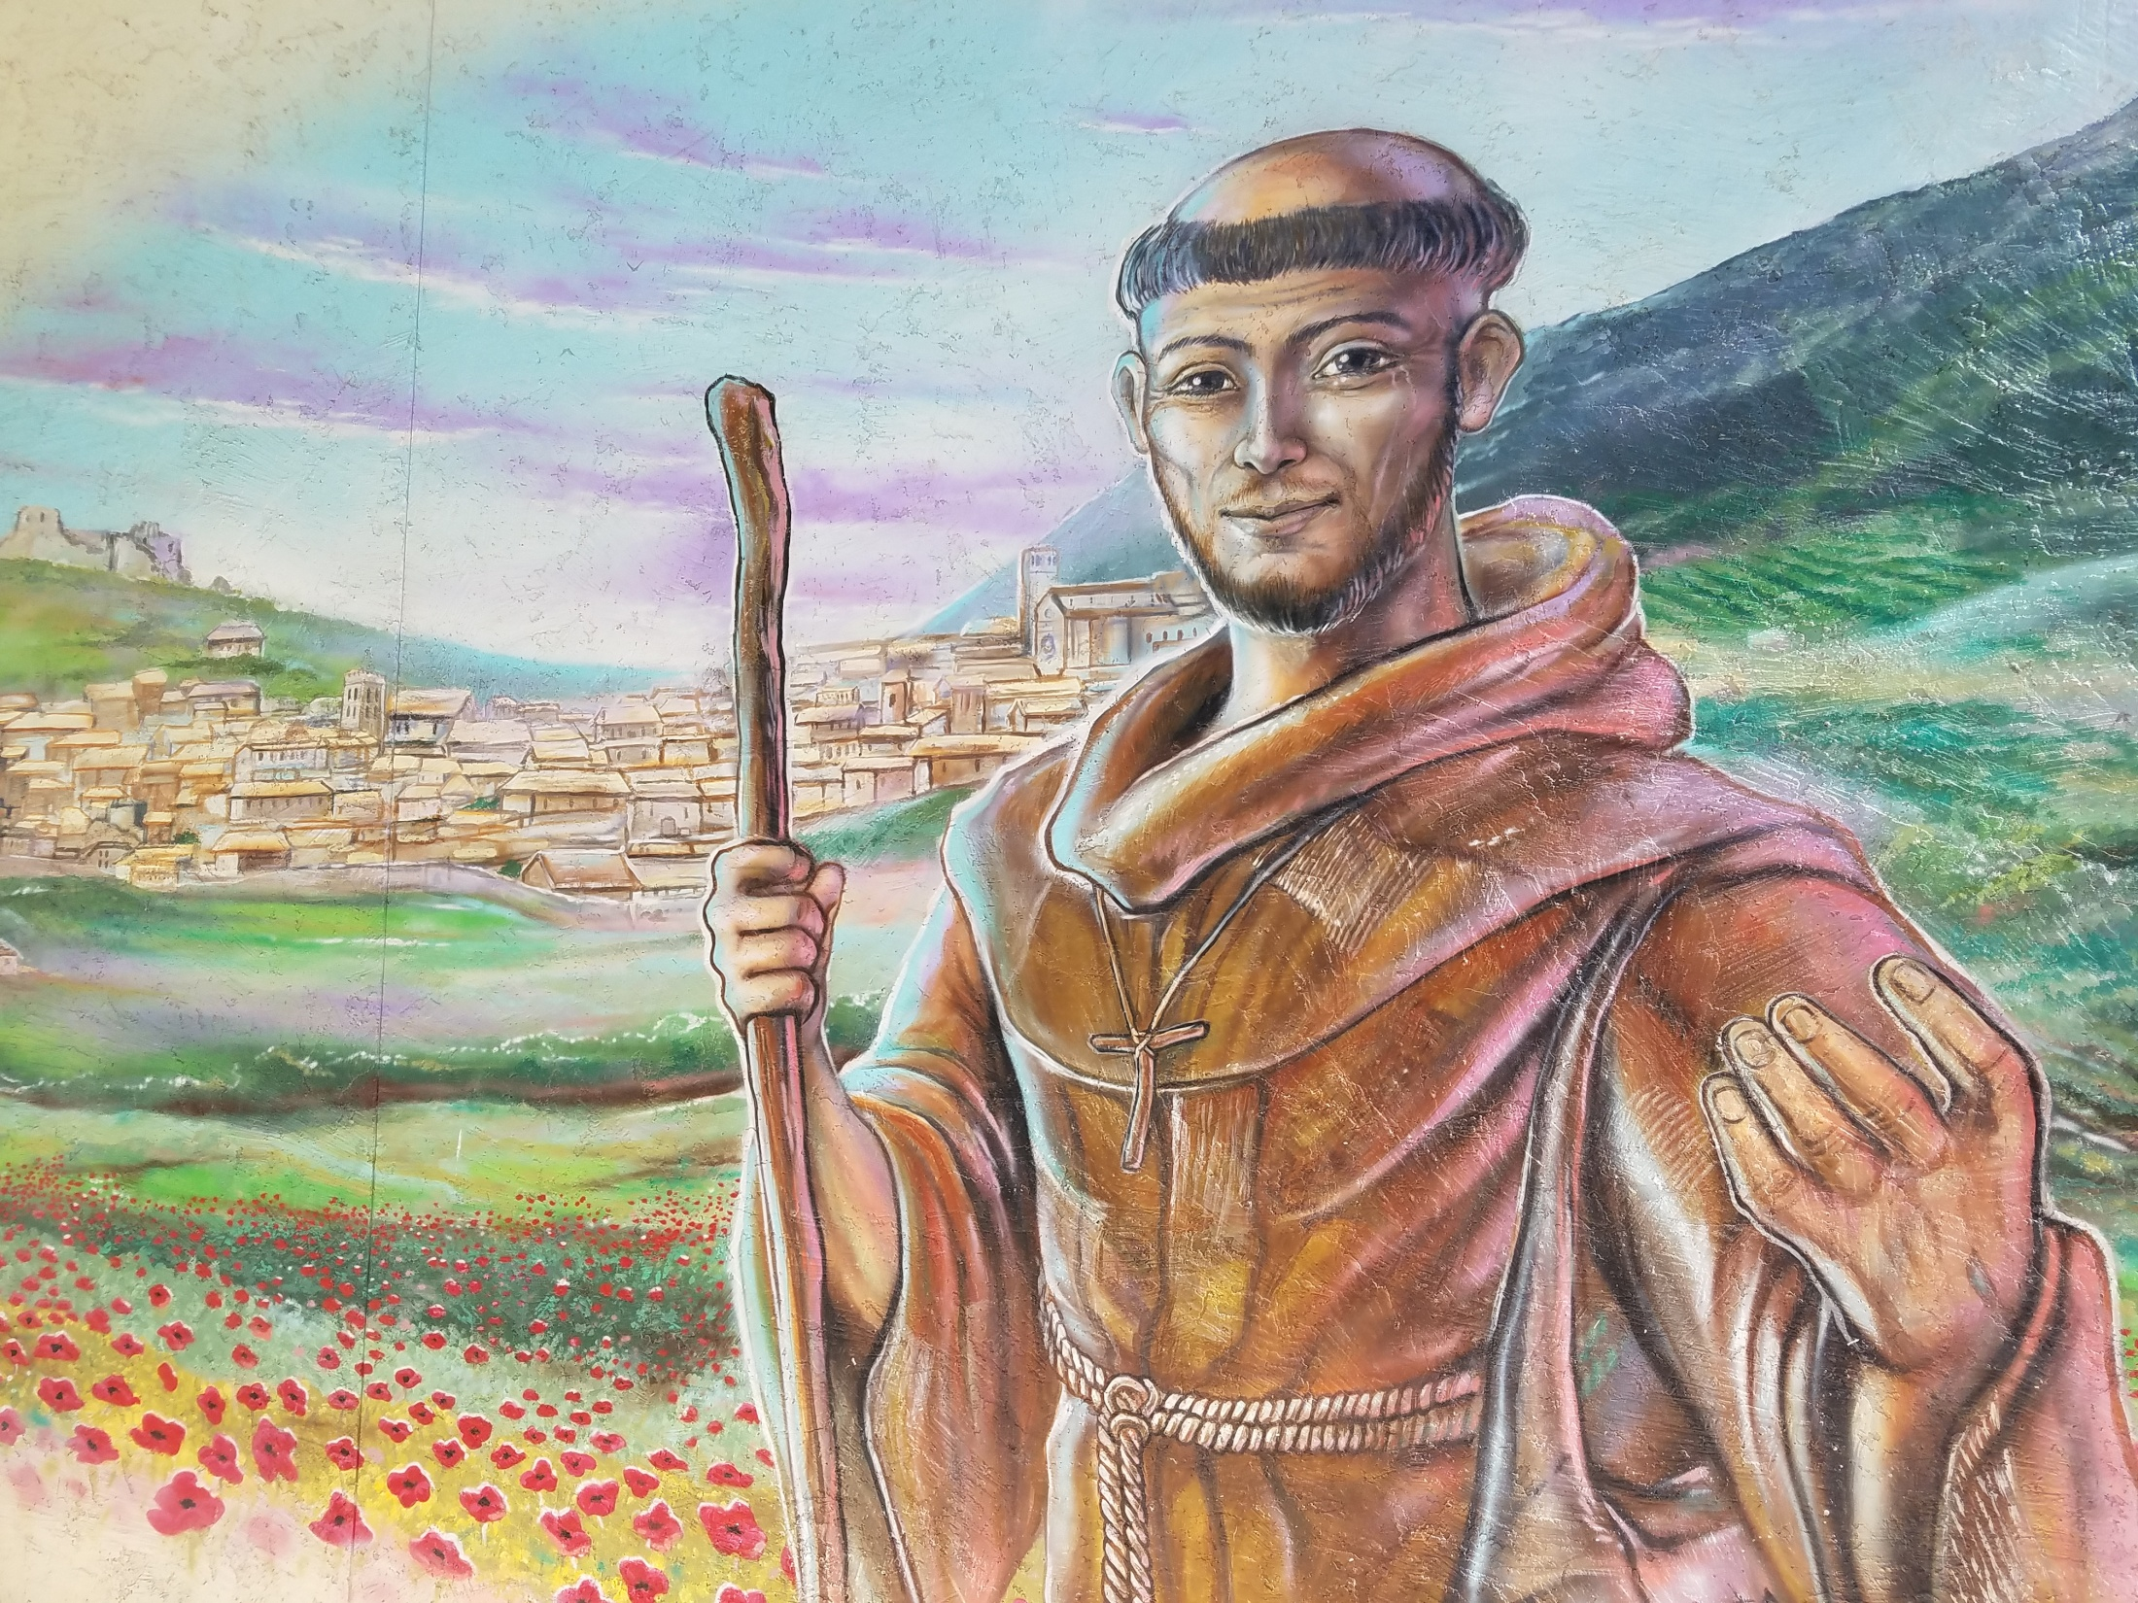
WELCOME

Slide 2
The members of
St. Maximilian Kolbe Fraternity

Slide 3
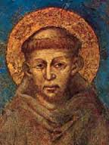
Francis of Assisi
Born 1181-82
Baptized Giovanni Bernardone
His father changed his name to Francesco
Died October 3, 1226

Slide 4
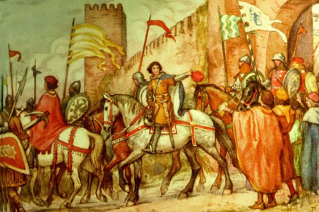

Slide 5
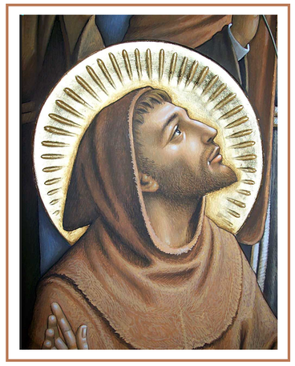
FRANCIS
From “King of frolic”
To “Poverello”

Slide 6
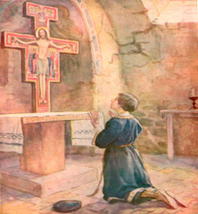
Prayer of Saint Francis before the Cross at San Damiano
“Most High,
Glorious God, bring light
to the darkness of my heart.
Give me right faith,
certain hope, and perfect charity,
insight and wisdom,
so I can always observe
Thy holy and
true command.
Amen.”

Slide 7
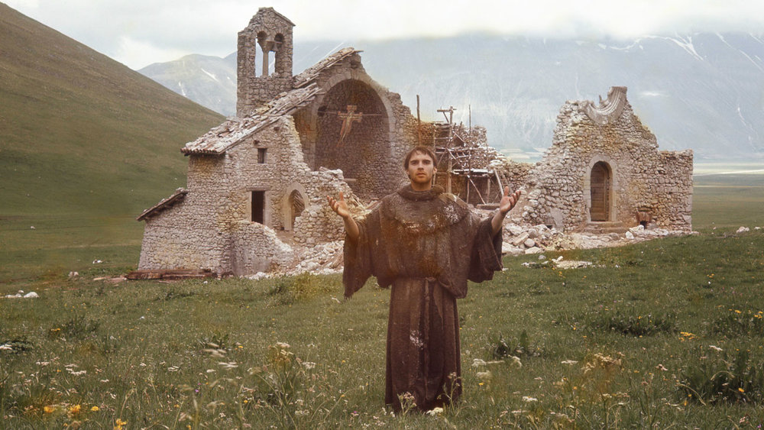
“Francis, Go repair my church…”

Slide 8
First Order - Order of Friars Minor
Second Order - Order of St. Clare
also known as Poor Clares (PC)
Third Order - Regular (TOR) -Religious
and Secular (OFS)- Lay

Slide 10
Franciscan Saints

Slide 12
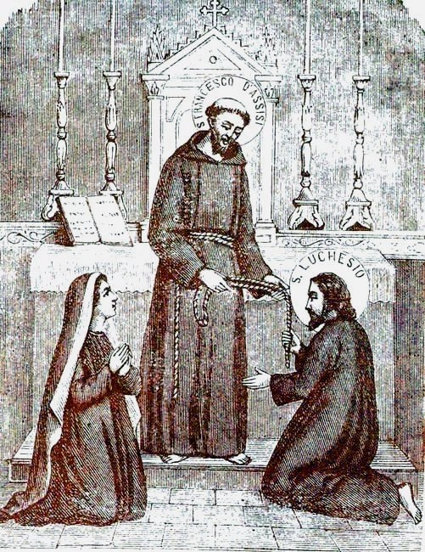
Brothers and Sisters of Penance
Third Order of St. Francis
Secular Franciscans (OFS)
Ordo
Franciscanus Saecularis

Slide 13
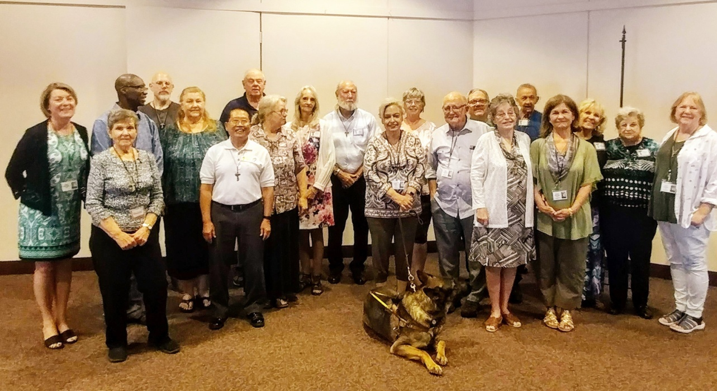
SECULAR FRANCISCAN ORDER
NOT a club or an organization
Religious ORDER
A big family

Slide 14
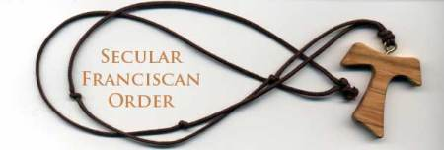
The TAU is our “habit”
A sign that we are Franciscans
on an amazing journey

Slide 15
Over 300,000 members world-wide
30 Regions in US
St. Thomas More Region
AZ and South/East NV
11 Local Fraternities
Over 200 Active Professed Members
About 40 members in formation

Slide 16
SOME ELEMENTS OF SECULAR FRANCISCAN LIFE:
Live in the world
Live Gospel of Jesus
Practice social JUSTICE, CHARITY and PEACE
Seek a life of prayers
Rely deeply on Holy Spirit
Observe daily conversion
Foster HOPE, LOVE and JOY
Enjoy a good Sense of Humor
Value Fraternity Life

Slide 17
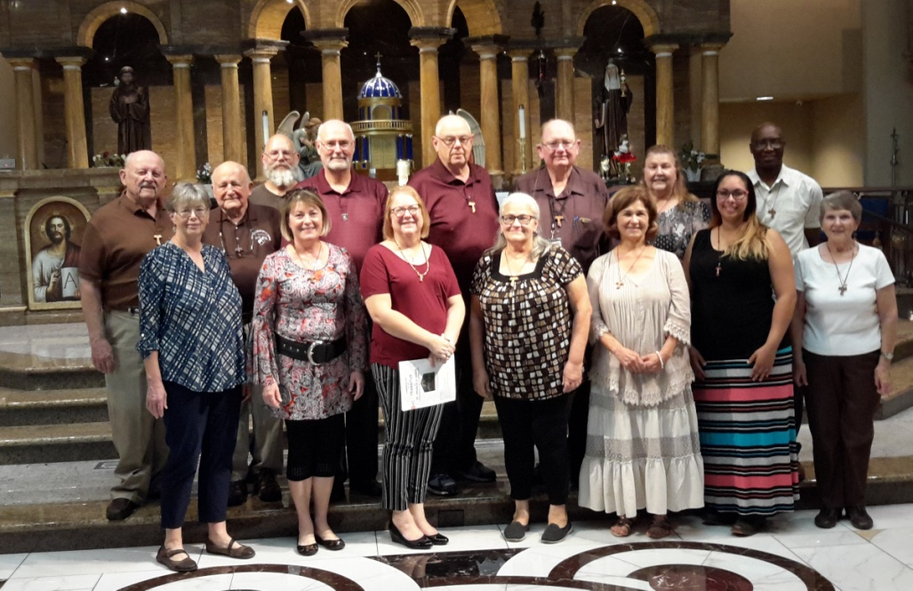
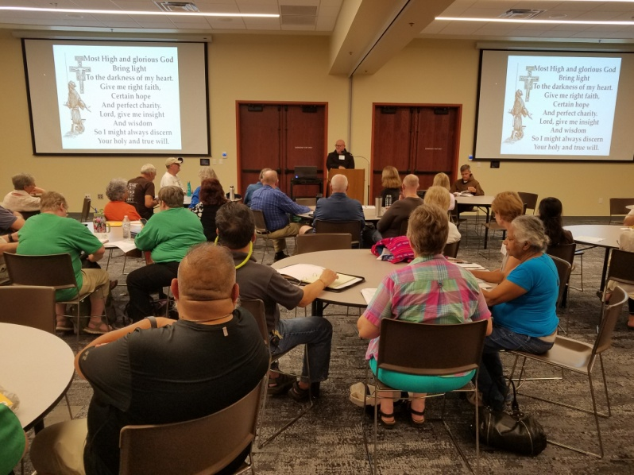
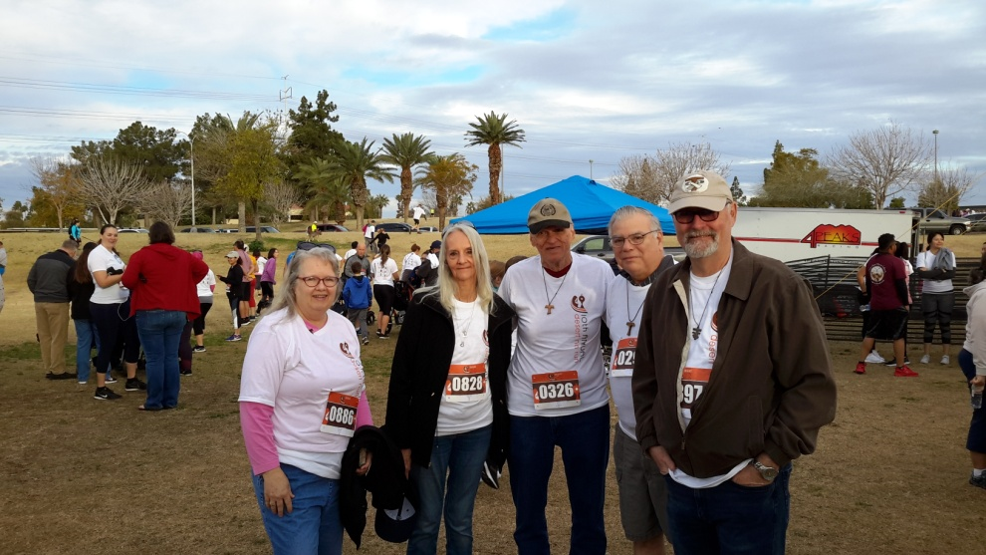
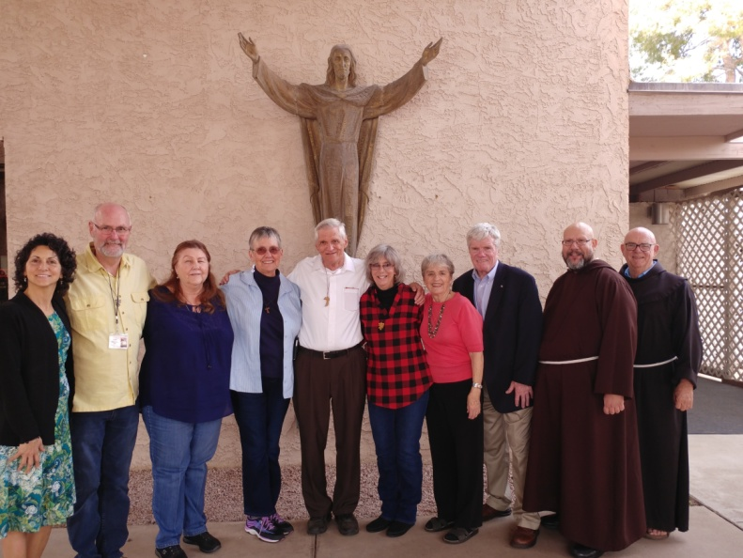
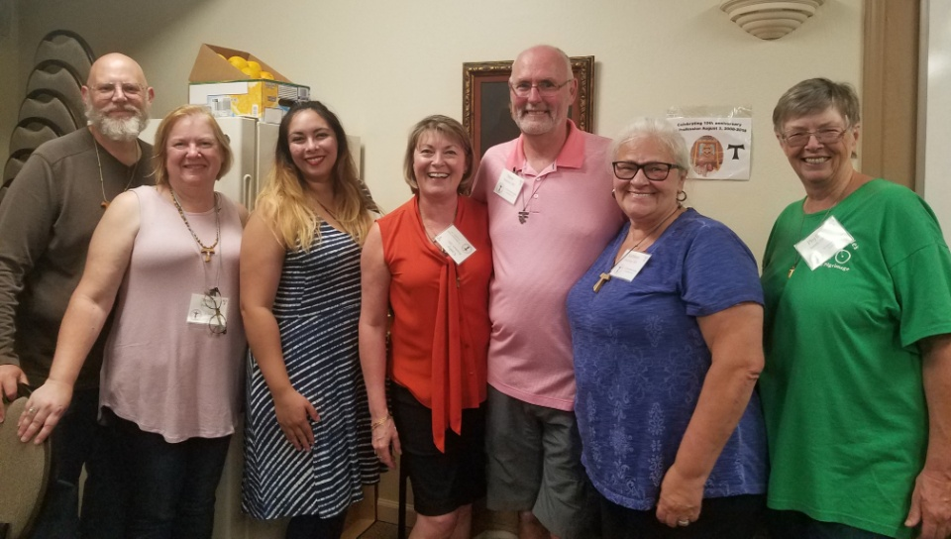

Slide 18
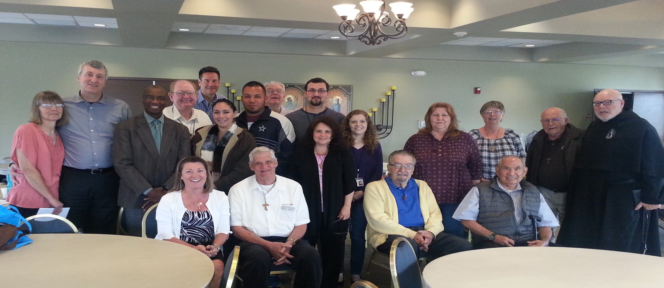
FRATERNITY
Love for God
Love for each other
Prayers, Formation & Fellowship

Slide 19
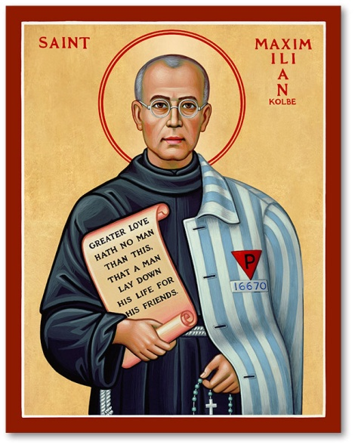
Saint Maximilian Kolbe
8 January 1894
14 August 1941
“No one has greater love than this,
to lay down one’s life for one’s friends”
John 15:13

Slide 20
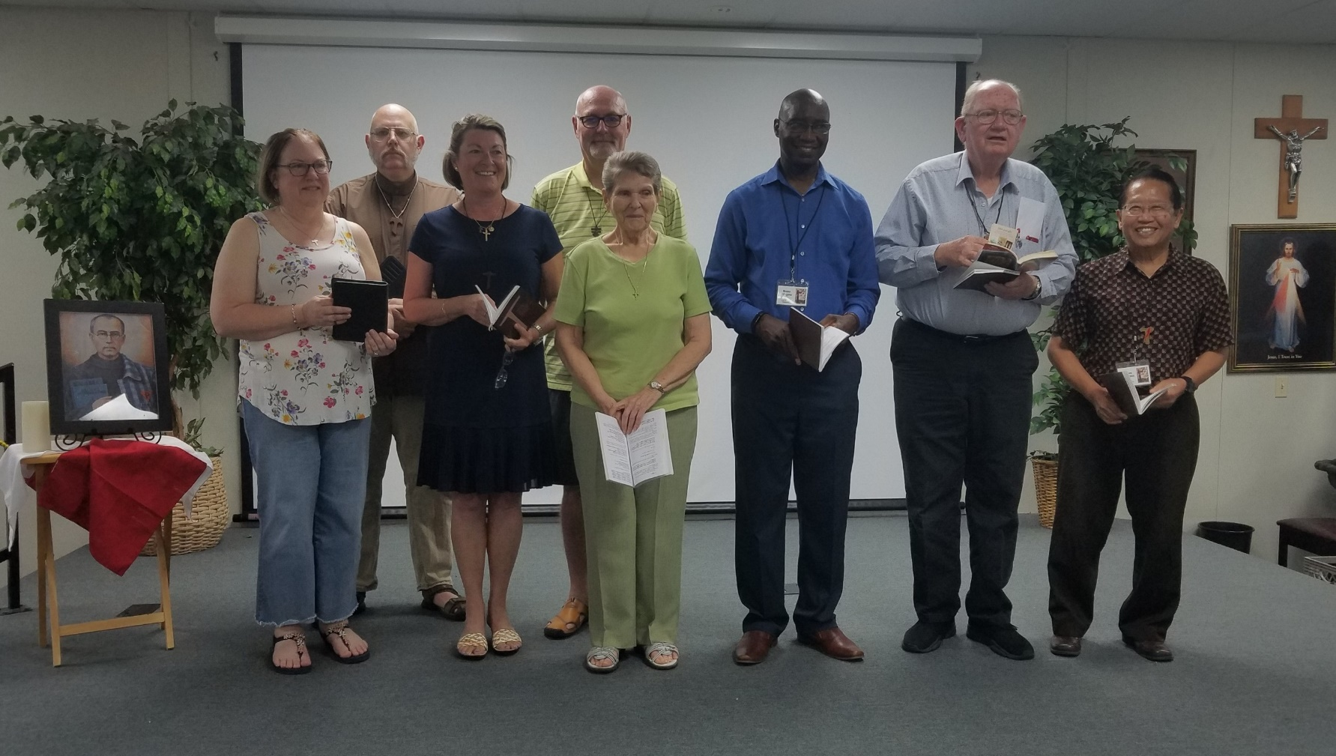
Servant Leadership

Slide 21
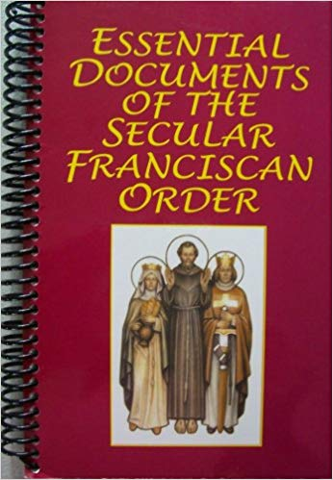
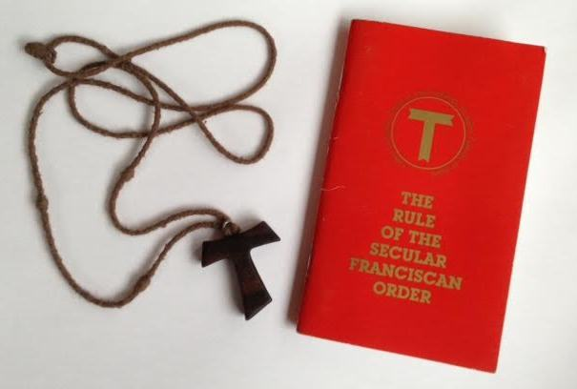
Essential Documents
General Constitutions
Rule
National Statutes

Slide 22
Rule of life of a Secular Franciscan
To observe the gospel
of our Lord Jesus Christ
by following the example
of Saint Francis of Assisi
(SFO Rule, article 4)

Slide 23
INITIAL FORMATION
27 to 36 months
3 stages:
Orientation
Inquiry
Candidacy

Slide 24
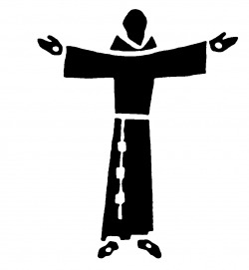
PROFESSION …
… a LIFETIME COMMITMENT
… a FORM OF EVANGELICAL LIFE
… a CONSECRATION to GOD

Slide 25
Come, walk with us
Come and see if this Franciscan life
is something you are called to live.

Slide 26
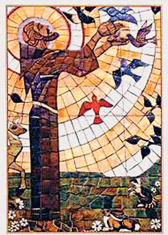
PACE E BENE
PEACE AND
ALL GOOD
PowerPoint created by Cathy Roszhart, OFS (2019)

