Slide 1
Article 25
“Regarding expenses necessary for the life of the fraternity . . . all the brothers and sisters should offer a contribution according to their means.

Slide 2
All the brothers and sisters: all active professed and all candidates According to their means: This is “fair share.” Not dues!! We may not assess anyone a set amount! Fraternity members give what they can.

Slide 3
“Local fraternities should contribute toward the expenses of the higher fraternity councils.” Contribution to the region comes from the fraternity, not from individuals. The regional council is not a fraternity; we have no means of income. We do not assess individuals the $40 for each active member that goes to the region.

Slide 4
Precedent in scripture: “Some thought that since Judas kept the common purse, Jesus had told him, ‘Buy what we need for the feast.’” Jn 13:29 “All who believed were together and had all things in common.” Acts 2:45 “. . . they brought the proceeds of their sales, put them at the feet of the apostles, and they [the proceeds] were distributed to each according to need.” Acts 4:35.

Slide 5
Fair share = FAITH!! Faith = the willingness to RISK!!
TRUST that the fraternity will be able to cover expenses.
Income can fluctuate monthly depending on each person’s ability.
When people are not told how much to give but see what is needed, they are generally much more generous.

Slide 6
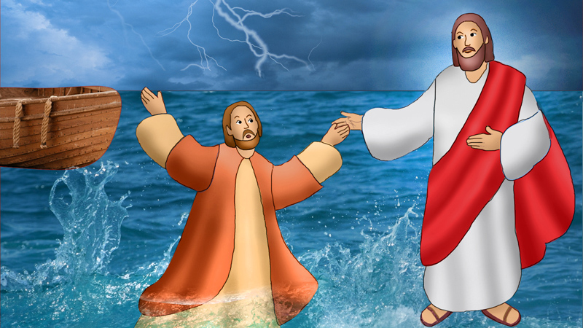
Google: Catholic Curier
Why are you afraid to take a risk?

Slide 7
“Thy Kingdom come” means my kingdom goes! St. Clare’s request for the “privilege of poverty” meant that the sisters would not accept dowries to make the monastery financially independent. FAITH is the willingness to take a RISK!!

Slide 8
Lady Jacoba Fraternity
8 professed + 2 candidates = 10 active members
They meet monthly.
Four people have been coming to the gatherings and may well come into formation.
Question: What do we need to operate this year?

Slide 9
Anticipated expenses: budget committee or council.
Contribution to region: $40 per active member
$40 x 10 = $400.
Formation: anticipate 4 people
Books: 5 @ $20 each = $100
Welcome gifts: 5 @ $20 each = $100
Rite of Admission: 5 @ $10 each = $50
Copy expenses: $50
Total formation expenses: $300
Spiritual assistant stipend: $25 x 11 = $275
Facility rental: $50 x 11 = $550
Miscellaneous: $100

Slide 10
Add the projected totals for each category:
Contribution to region $400
Formation $300
Spiritual assistant $275
Facility rent $550
Miscellaneous $100
TOTAL $1,725
Monthly needed income ($1725/11) = $157.00

Slide 11
Share anticipated expenses (budget) with the fraternity.
! We are an organic union – ALIVE!
We cannot request a set amount from each member.
When people see what’s needed, they will plan accordingly.
2 members give $10 a month ($20)
1 member gives $5 a month ($5)
3 members give $20 a month ($60)
2 members give $25 a month ($50)
2 members give $40 a month ($80)
Total monthly income = $215
You have exceeded the needed $157 by $58!! Yeah!! TRUST!

Slide 12
Treasurer Report
Transparency
Report income and expenses regularly.
Nothing fancy
Income was $215.00 “Thank you.”
We spent $97.20 on …..
Ask permission to spend for new unexpected expenses.
Thank the members for last month’s income.
The more the membership is involved, the more they understand the needs and they will contribute!!

Slide 13
Prioritize!
Meet the needs of the fraternity first.
Extra activities come out of excess.
Charitable giving comes out of excess.
We like excess!!
Parable of the unjust steward.

Slide 14
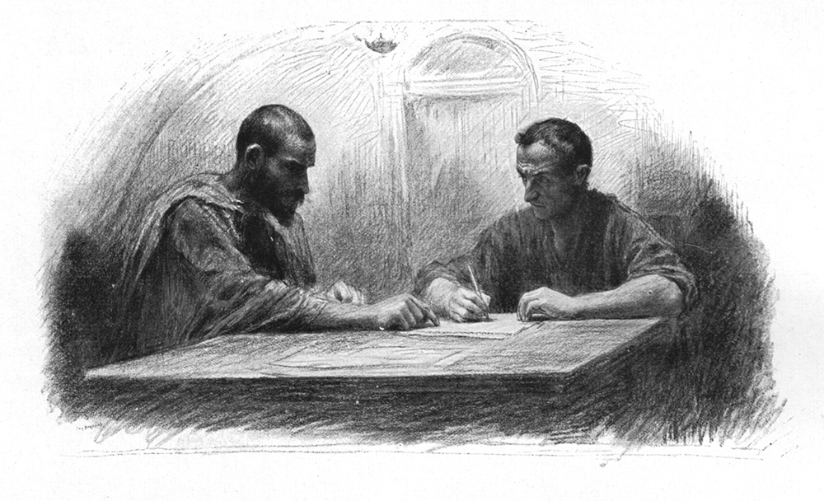
Google: St John One: One

Slide 15
Impact drives Income
If you have quality programs, people will give.
If people feel welcomed and part of a community, they will give.
If your program is worth driving across town for, people will give.
If you share a brief financial report each month, people will see the fraternity needs and may give more.

Slide 16
Formation is critical!
Formation needs to be a priority in your fraternity.
Initial formation AND ongoing formation
Those entering formation do not buy their own materials.
When the fraternity invests in formation, every member of the fraternity has a part in the formation program.
The formation director does not pay for formation materials out of his/her pocket.
“Extra” money can be used for scholarships for retreats, the Q, and for speakers for your ongoing formation programs.

Slide 17
Keep good records.
Secretary – maintain accurate attendance records.
Treasurer – maintain accurate contribution records for each fraternity member.
Active member status is determined by
Attendance
Contribution
Maintain confidentiality about individual contributions.
Check on those who are not in attendance.
All this is spelled out in our Constitutions and Statutes.

Slide 18
Google: Rev. Laurie Brock

Slide 19
When we want something we don’t have, we may have to do something we haven’t done! “Fear not!” Take a RISK and give it a try. Let go of our egos.

Slide 20
Conversion calls us to
Google: TonyWolfe.net

Slide 21
Lady Jacoba Fraternity
is a
strong,
vibrant,
welcoming,
healthy
community --
a life-giving union in the Franciscan family. (Rule, art. 1).

