Slide 1
COMMUNICATION
PowerPoint presentation created by Cathy Roszhart, OFS - 2023

Slide 2
NAtional FRAternity Council (NAFRA) priorities: for 2022-2025 Vocations, COMMUNICATIONS, Relationships

Slide 3
Exchange of information by speaking, writing, or other medium
WHAT IS COMMUNICATION?

Slide 4
Successful conveying or sharing of ideas and feelings
WHAT IS GOOD COMMUNICATION?

Slide 5
Communicating clearly and reliably with others
Essential tool to foster healthy relationships

Slide 6
Prayerful connection with all our brothers and sisters
WHAT IS GOOD FRANCISCAN COMMUNICATION?

Slide 7
“The local fraternity is a visible sign of the Church, a community of faith and love.
Together with all the members
We pledged ourselves
to spend our efforts to make the fraternity
a genuine ecclesial assembly
and a living Franciscan community.”
Rite of Profession, Ritual of the Secular Franciscan Order].

Slide 8
FRATERNAL COMMUNITY = FRATERNITY
COMMUNICATION
leads us to
COMMUNING with each other
which leads to a stronger bond of
COMMUNITY.

Slide 9
Vital elements
for fraternity life:
FORMATION
JPIC
COMMUNICATIONS
SPIRITUAL ASSISTANCE

Slide 10
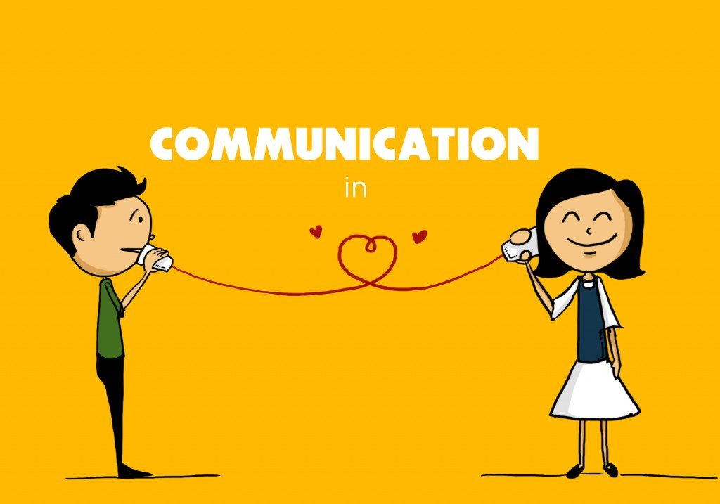
Tools for Communication
Gift of Technology… a precious blessing!

Slide 11
Regional Website: https://www.stmregionofs.com/
National Website:
https://www.secularfranciscansusa.org/

Slide 12
Ways YOUR REC is reaching out to you:
Each local fraternity assigned a Councilor to be a liaison between you and the Region
Regularly updating information on Regional Website
Publishing quarterly newsletter: “Our Fraternal Scoop”
Offering meetings and retreats via Zoom
Constantly updating our Database and Regional Directory
Communicating frequently via Email

Slide 13
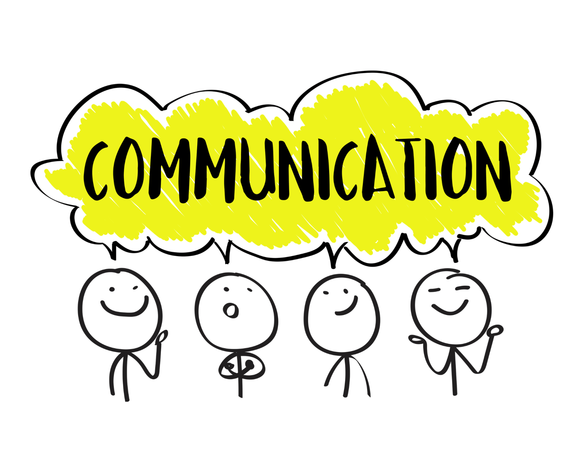
EMAIL ETIQUETTE
Acknowledge receipt of Email
Respond in a timely manner
Use “reply to all” sparingly

Slide 14
We need your feedback…
How is the communication between my local fraternity members? Do all feel a close connection?
Are the resources mentioned so far helpful in promoting a strong fraternal bond between all our members?
Do all members of your local fraternity feel connected to their brothers and sisters in our region?

Slide 15
FRATERNAL COMMUNITY = FRATERNITY
COMMUNICATION
COMMUNING
COMMUNITY
Are all essential for health, happiness,
relationships, teamwork and life
FOR THE GOOD OF OUR ORDER

